Slide 1
Measurement
PSYCHOMETRICS

Slide 2
Intelligence
What is it? And from where does it come?

Slide 3
Objectives
Introduce intelligence
You do an intelligence test
Talk
Class discussion
Personality Test

Slide 4
Intelligence
What do we think this is?
Notes:
Bit of a class discussion here, have they heard of IQ tests. Some will have heard of EQ (certainly those who have read books on relationships)
Have any done intelligence tests
Do they remember scores?
Do you think this is useful

Slide 5
Try these Questions
A) You buy 3 bars of chocolate at 29p each and 10 stamps at 33p each. How much change do you get from £5?
B) Which of these are spelt correctly? Fulfiled Inoculation Embarass
Hypocracy Superseded Desicate
C) Find the next two numbers in these series:
i) 1 3 6 10 15
ii) 2 4 3 9 4
D) Find the odd one out in each series:
i) Peach Banana Tomato Plum
ii) Knife Plate Scissors Fork
E) You have to find a suitable new flatmate as quickly as possible.
What sequence of actions would you take?
F) How many uses can you think of for a dustbin lid?
Notes:
INSTRUCTOR’S NOTES
TOPICS RELATING TO THIS EXERCISE
Intelligence testing, cognitive development.
STRUCTURE
Students need to work individually.
PURPOSE
To encourage debate about the nature of intelligence and how to measure it.
USING THE EXERCISE
This exercise looks at some of the types of question used in intelligence tests. Each section
can be tackled and discussed separately.
These are not examples from real tests and the purpose is not to test students’
intelligence, but for them to be critical about these types of test.
Students do tend to believe that traditional arithmetical items test intelligence best, and
may reject items that appear to test “common sense”. They should be challenged to see if
they can justify this judgment.
A) Answer 83p. Do strategies help? e.g. multiply 3 by 30p then take away 3p.
B) corrected spellings are: fulfilled, inoculation, embarrass, hypocrisy, superseded,
Desiccate How do we get these words right? Logic, practice, intelligence, memory?
C) 1 3 6 10 15 21 28—intervals between increase by one each time.
2 4 3 9 4 16 5—alternate numbers increase by one, each number is followed
by its square.
How important is practice and familiarity with this type of question? There could be other answers. Finding alternative answers could indicate a good degree of
mathematical ability and creative thinking, but the answers would be marked wrong in a test.
D) Is there a right answer? Do you need to know what is expected?
Is it tomato?—technically a fruit, but regarded as a salad vegetable.
Is it banana?—the only one that is not round and juicy.
Is it plate?—the only one that is not cutlery or made of metal.
Is it scissors?—the only one that is not used when eating.
E) To answer this well, do you use knowledge, logic, “common sense” or something else? Is common sense a form of intelligence?
Certainly the best answer should be both practical and effective.
F) You would not expect this sort of question when your academic ability is assessed, but might encounter it as part of an employer’s recruitment procedure.
Extra points would normally be given for more creative ideas, especially those which other people do not think of. (A template for drawing Olympic rings in the sand was one such idea). Should creative ideas also be practical ones to score well?
Discussion points
❖ For each question: what kind of intelligence may be being tested?
❖ Fluid intelligence? (novel problems: reasoning and problem solving).
❖ Crystallized intelligence? (e.g. knowledge acquired leading to a good vocabulary
and ease of mental arithmetic etc.)
❖ Or other kinds of intelligence (such as those suggested by Gardner)?
❖ What kinds of abilities do you think should be included in intelligence testing?
❖ Are any of the tests culturally biased in favour of white native-born middle class
people?
❖ Is it possible to test intelligence when there is no consensus as to what it actually
is?
❖ Instead of focusing on testing intelligence, is it more valuable to understand how
intelligence works: the role of memory, methods of problem-solving, use of
knowledge and strategies (Sternberg’s theory, information-processing approach)?
❖ What are the applications of this approach e.g. in teaching and learning?

Slide 6
World’s Shortest IQ Test
1. A bat and a ball cost $1.10 in total. The bat costs $1 more than the ball. How much does the ball cost?

Slide 7
IQ Test
2. If it takes 5 machines 5 minutes to make 5 widgets, how long would it take 100 machines to make 100 widgets?

Slide 8
IQ Test
3. In a lake, there is a patch of lily pads. Every day, the patch doubles in size. If it takes 48 days for the patch to cover the entire lake, how long would it take for the patch to cover half of the lake?

Slide 9
Answers
Question 1 $0.05
Question 2 5 Minutes
Question 3 47 Days
The ideas come from Daniel Kanneman’s Thinking Fast and Slow – Penguin Books
Notes:
Answers:
$0.05. If you guessed 10 cents, you’re not alone. However, if that were the case, the bat and ball would cost $1.20—not $1.10. On the other hand, purchasing a 5 cent ball and a bat priced at $1.05 (which is $1 more expensive than 5 cents) would total $1.10, instead.
5 minutes. Although you might have answered 100 minutes, the actual time is a little less than that. Since the question reveals that it would take 5 minutes for 1 widget machine to make 1 widget, you can determine that it would take 5 minutes for 100 widget machines to make 100 widgets.
47 days. At first, your gut might tell you it would take 24 days. But remember: Since the area of the lake covered in lily pads doubles every day, a patch that covers half the lake would fully cover it in just one day. Subtract one day from 48 days, and what do you get? 47 days.

Slide 10
The Intelligence Debate
Can Intelligence be measured
What is intelligence
What is meant by Intelligence Quotient (IQ)
Is what we are measuring useful (ecologically valid). What problems did our ancestors have and does IQ correlate with evolutionary success (Kanazawa 2004)
Notes:
So we have shown that we can’t really agree on what intelligence is?
Is this a discriminatory tool. Forrest Gump was successful, but of low IQ
IQ is probably a socially constructed concept. It relates almost exclusively to book learning or school smarts.
I suspect I have more academic qualifications than Ray Mears, but who would you want to be lost in the woods with? Or who would you want to be with if you ended up in a crashed airline on a south sea island with nobody looking for you?
Intelligence could be described as the ability to learn from experience and historically this has been seen as school learning.
Easy to measure?

Slide 11
Intelligence
Two big areas of discussion
Is intelligence a single ability or several abilities
Spearman (1863-1945) argued for the notion of a generalised intelligence. He called this (g)
Or a range of abilities e.g. Turnstone (1887-1955) found intelligence was in clusters, he identifies 7 Gardner agues 8-9 types of intelligence
Notes:
Two big areas of discussion
Is intelligence a single overall ability or several specific abilities.
Probably need to introduce the concept of correlation here
But we can all think of people we know who are good at one thing, but hopeless at others, I have met many absent minded professors, many proud of the fact. What about artist who can’t add up.
Can we name a polymath, Jonathan Miller, Stephen Fry, Melvyn Bragg, Laurie Taylor Notice the radio 4 connection
Charles Spearman argued that there is evidence that many intelligences are closely linked. The ability to do verbal reasoning, spatial manipulations and mathematical problem solving are linked.
He used (invented) a statistical procedure called factor analysis to support his theory. This essentially is a correlation of everything with everything else to see what the connection is between all the factors
If we think about this in terms of athletics, a good rower is likely to be a better than average runner.
Turnstone (1887-1955) set up a series of 56 tests and found seven clusters of mental abilities.
Word Fluency, Verbal Comprehension, Special Ability, numerical ability, perceptual speed, inductive reasoning, memory
But back to Ray Mears, would abilities of this help our ancestors, does the ability to do maths mean that you make more babies. Kanazawa 2004 found some connection between academic skills and the skills to find a mate, be a good parent, find your way without a map and social comprehension

Slide 12
Single Measure
IQ suggests that a single measure covers many abilities
Grammar School Test
Let’s plot height against shoe size

Slide 13
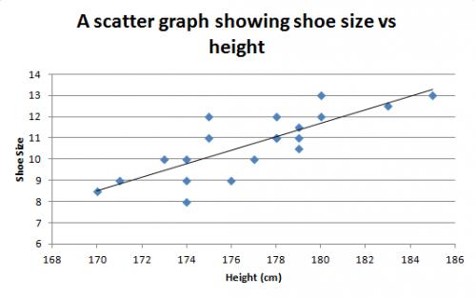
Results?

Slide 14
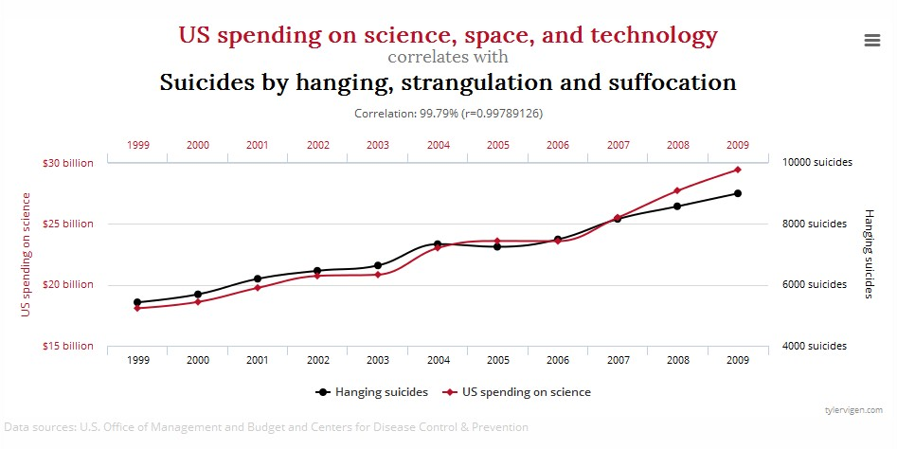
Be Careful!
Causation and Correlation

Slide 15
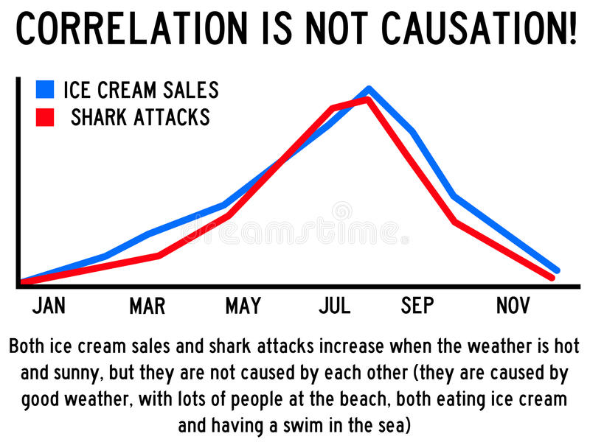

Slide 16
Multiple Intelligences
Current theory suggests that there are multiple intelligences (Howard Gardener 1998)
Gardener suggest that there may be 8 areas of intelligence:
Linguistic, logical-mathematical, musical, spatial, bodily-kinaesthetic, intrapersonal, interpersonal, naturalist.
He posits, that there may be a ninth Existential intelligence
Notes:
Howard gardener has a home page
Linguistic poets
logical-mathmatical Scientists
Musical Musicians
Special Artists and artisans
bodily-kinesthetic Athletes
Intrapersonal People who understand themselves
Interpersonal People who understand others
Naturalist People who understand the natural world around them
He posits, that there may be a ninth Existential intelligence The ability to understand big questions, meaning of life, why are we here sort of questions

Slide 17
Robert Sternberg
He argues that there are only three areas of intelligence
Academic
Creative
Practical
Research in this area is very business orientated, with emphasis on career goals and work achievements and competencies
Notes:
Academic Good at problems with well defined answers
Creative can adapt to novel situation and generate novel ideas
Practical Good at solving everyday tasks

Slide 18
Daniel Goleman (1996)
Emotional Intelligence
Goleman argues that the ability to react well in social areas has been largely ignored and this should be an area for research.
Much is being done in this area, especially in education and management

Slide 19


What does IQ Test Measure
This?
https://www.youtube.com/watch?v=3u2qRXb4xCU

Slide 20
Personality Theory
Notes:
Lets start by asking about what do you know about psychoanalytic theory so far, have you come across the concepts before.
What about other areas of your life:
TV shows Frasier, American shows where they use the word analyst
What about books?

Slide 21

Without much
Strong
Big
What is ‘personality’?
Famous
Real
Notes:
Lets look at the work book. Think of how you would describe people, would you use a scale like happy-sad. Put some adjectives next to the lines and think how you would rate people
Type A / B Personalities
Meyer Friedman, an American cardiologist, noticed in the 1940's that the chairs in his waiting room got worn out from the edges. They hypothesized that his patients were driven, impatient people, who sat on the edge of their seats when waiting. They labelled these people "Type A" personalities. Type A personalities are work-aholics, always busy, driven, somewhat impatient, and so on. Type B personalities, on the other hand are laid back and easy going. "Type A personality" has found its way into general parlance.

Slide 22
A definition of ‘personality’
“Those relatively stable and enduring aspects of individuals which distinguish them from other people, making them unique, but which at the same time permit a comparison between individuals.” (Gross, 1992)

Slide 23
Is personality...
Learnt (Kelly) or inherited (Eysenck)?
Permanent (Eysenck) or changing (Mischel)?
The study of unique individuals (idiographic - Freud) or to discover general factors (nomethic - Eysenck)?
Links to nature and nurture for both intelligence and personality
Notes:
This is where debate starts. I want you to think back to your debate about the nature nurture argument where you examined where intelligence was thought to lie, in the genes or is it a personal thing that is learned
Draw lines on white board
Lets look at the first line shown, are we affected by others, is our personality stable or does it change. Do you have the same personality as a parent, are you turning into your mother/father.
Implict in this is does personality change. Joe Walsh (The Eagles) has a line in one of his solo songs (life’s been good) that goes something life everyone’s so different I haven’t changed
The song is about the reminicences of a rock star
Then there is the argument that trying to categorise personality is hopeless as we are all different and should be categorised as such.

Slide 24

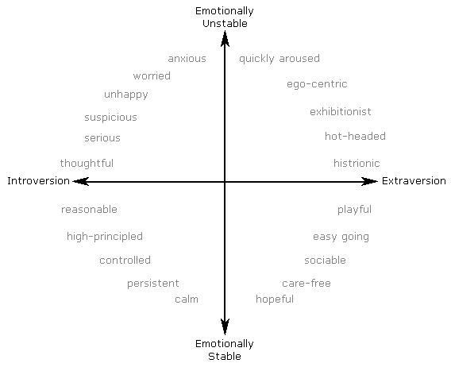
Personality Test

